Slide 1
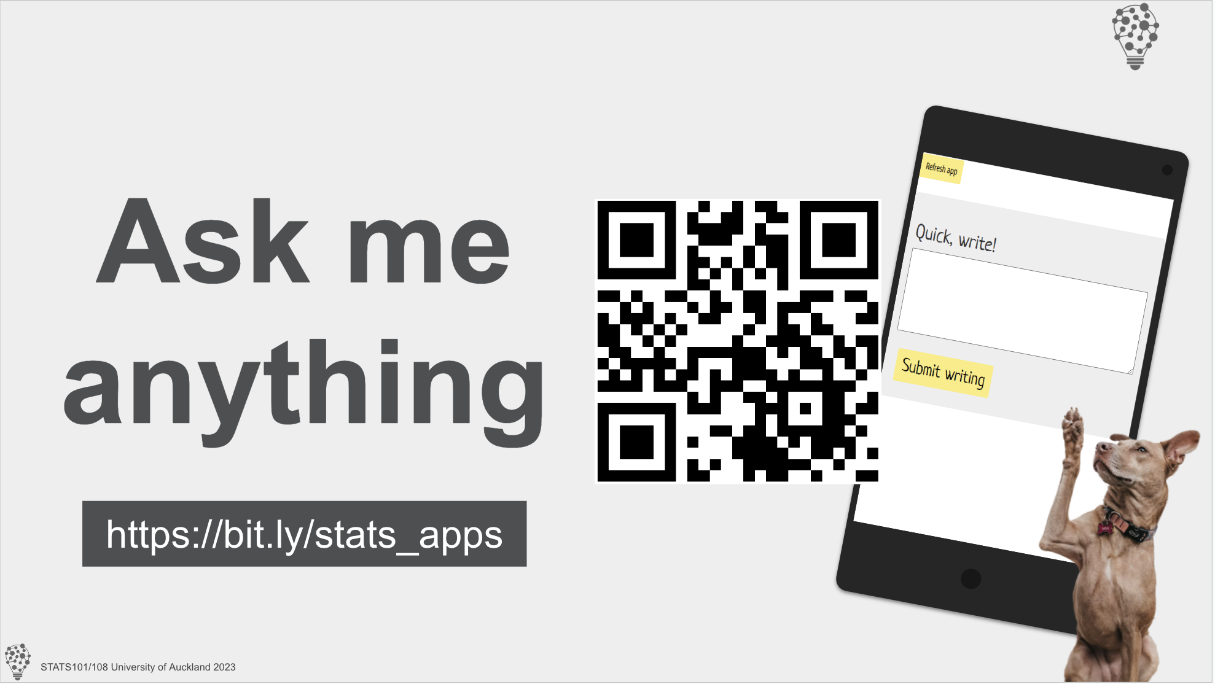

Slide 2
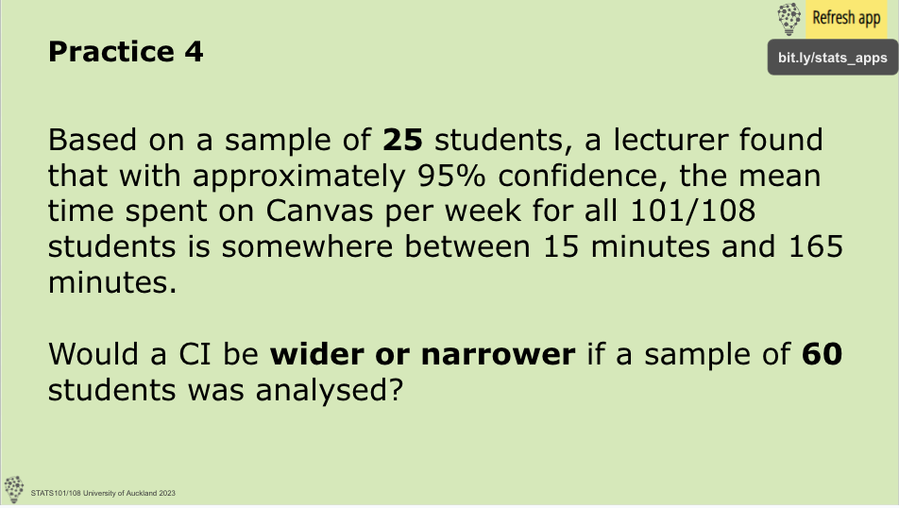
THINK NOW but write later

Slide 3

Thursday study groups
Chapter tasks
Test prep
10am to 12pm
302-170

Slide 4
Drop-in help session
Chapter tasks
Test prep
Mondays & Tuesdays
10am to 4pm
302-170

